Slide 1
Nano Server

Slide 2
File server
Create/Modify/Delete File/Folder
Share Across User to access files

Slide 3
What is nano server
Nano Server, which offers a minimal-footprint headless version of Windows Server. It excludes the graphical user interface, WoW64 (support for 32-bit software) and Windows Installer. It does not support console login, either locally or via Remote Desktop Connection. All management is performed remotely via Windows Management Instrumentation (WMI), Windows PowerShell and Remote Server Management Tools (a collection of web-based GUI and command line tools).^{[25]} However, in Technical Preview 5, Microsoft has re-added the ability to administer Nano Server locally through PowerShell. According to Microsoft engineer Jeffrey Snover, Nano Server has 93% lower VHD size, 92% fewer critical security advisories, and 80% fewer reboots than Windows Serve

Slide 4
What is nano server
Removed Window Shell
Removed Internet Explorer
Removed Local GUI Management
Removed 32 Bit Support
Removed GDI and all Graphics Support (No Drivers Installed)
Remove Remote Desktop
WinLogon
Support PowerShell

Slide 5
Why nano server
Smaller
Lighter
Faster Weight
Consume few resources
Can Add Customized Package
IIS
Hyper V-Support

Slide 6
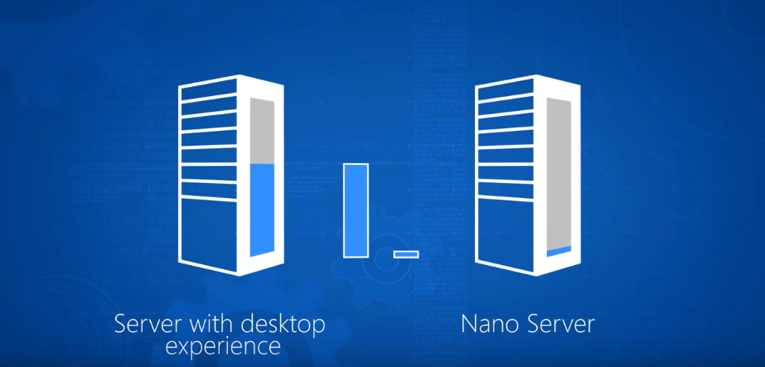
Nano Server 25% Smaller than Server with desktop Experience

Slide 7
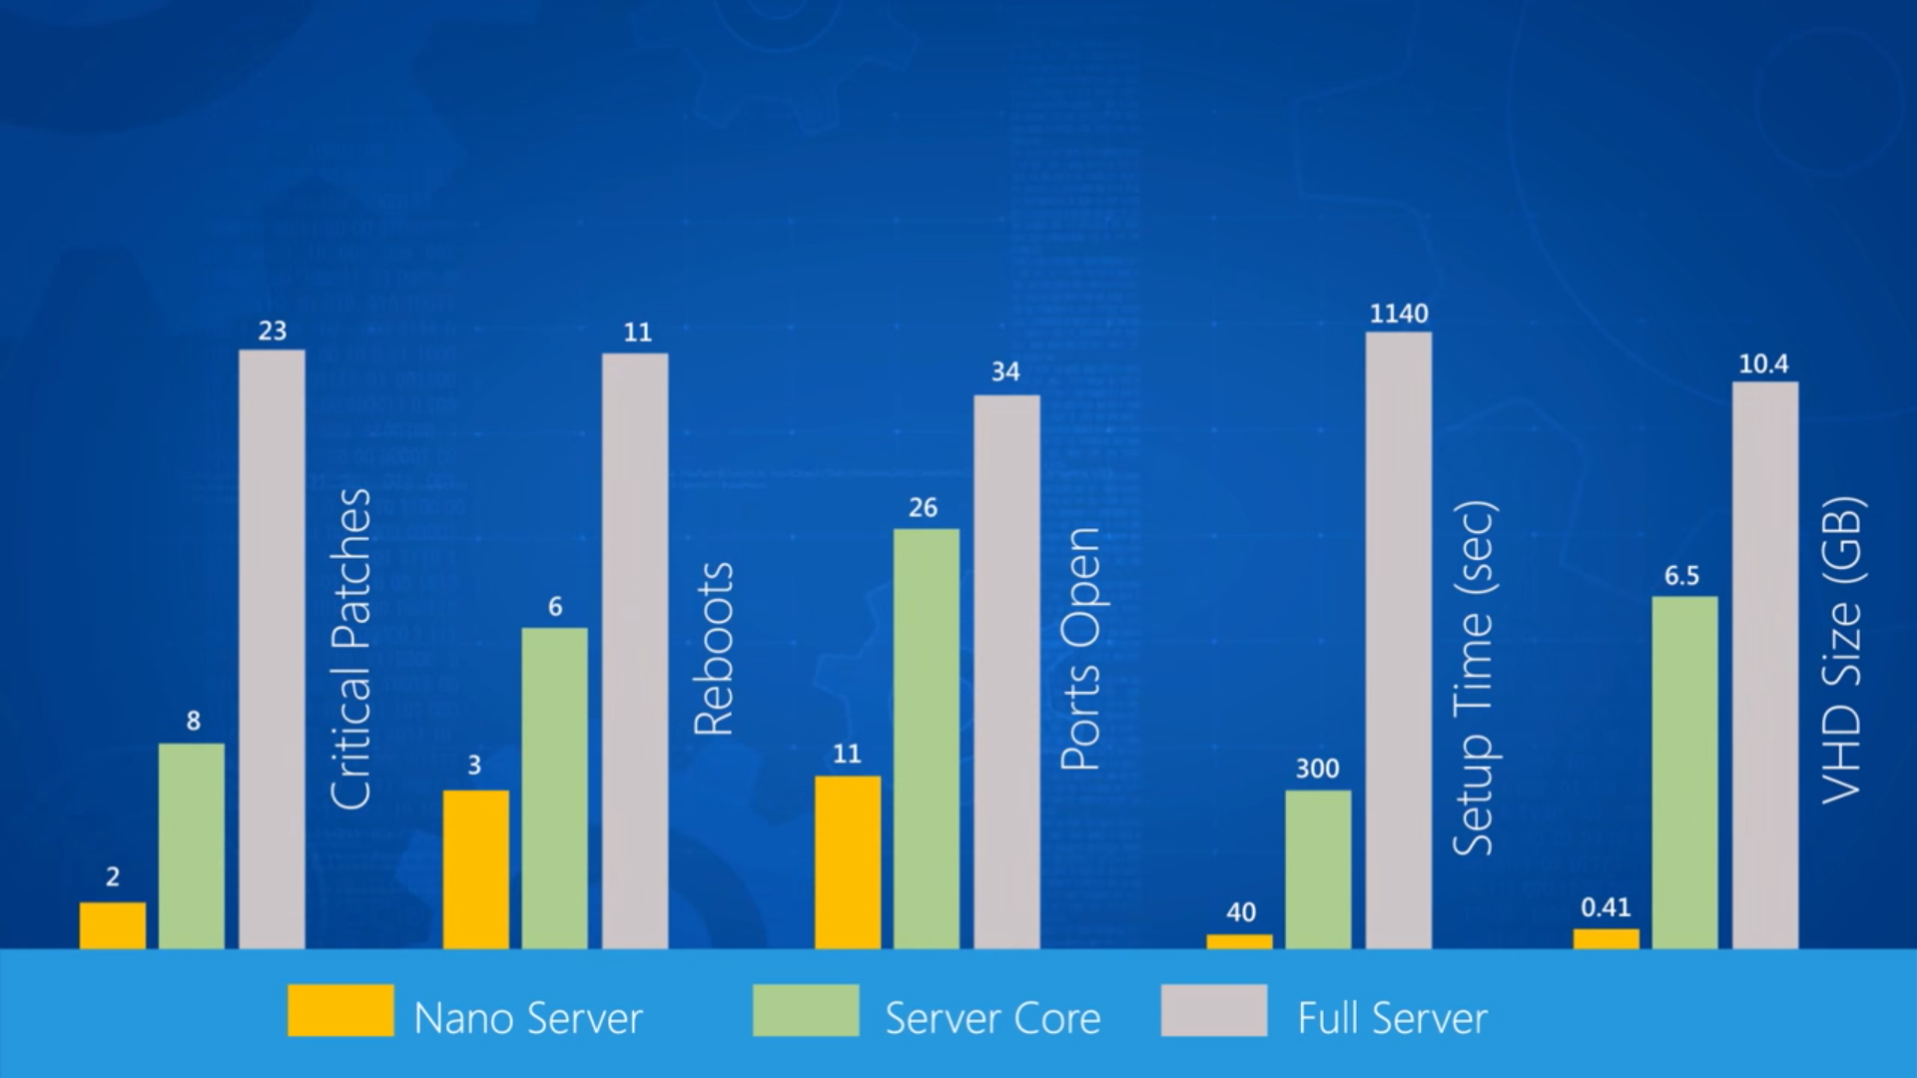

Slide 8
Nano Server is ideal for a number of scenarios
As a "compute" host for Hyper-V virtual machines, either in clusters or not
As a storage host for Scale-Out File Server.
As a DNS server
As a web server running Internet Information Services (IIS)
As a host for applications that are developed using cloud application patterns and run in a container or virtual machine guest operating system

Slide 9
Nano Server Limitation
Nano Server is "headless;" there is no local logon capability or graphical user interface.
Only 64-bit applications, tools, and agents are supported.
Nano Server cannot serve as an Active Directory domain controller.
Group Policy is not supported. However, you can use Desired State Configuration to apply settings at scale.
Nano Server cannot be configured to use a proxy server to access the internet.
NIC Teaming (specifically, load balancing and failover, or LBFO) is not supported. Switch-embedded teaming (SET) is supported instead.
System Center Configuration Manager and System Center Data Protection Manager are not supported.
Best Practices Analyzer (BPA) cmdlets and BPA integration with Server Manager are not supported.
The version of Windows PowerShell provided with Nano Server has important differences. For details, see PowerShell on Nano Server.
Nano Server is supported only on the Current Branch for Business (CBB) model--there is no Long-Term Servicing Branch (LTSB) release for Nano Server at this time. See the following subsection for more information.

